Slide 1
Brand Guidelines
August 2020

Slide 2
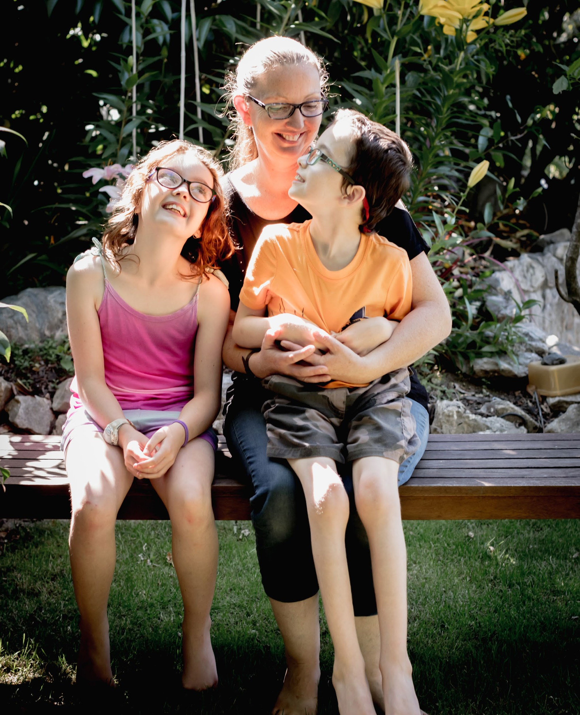

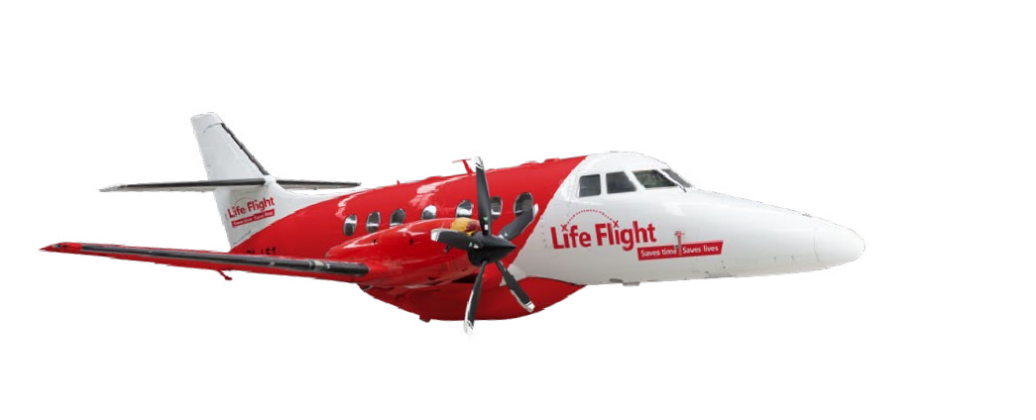



Abby and
“I don’t know if my daughter would have survived.”
—Katrina
Home safely
Hunter
Katrina, who lives in Nelson, was
29 weeks pregnant with her first child when she went into premature labour.
It was critical to stall labour for as long as possible, so Katrina was urgently flown by Life Flight to Wellington Hospital’s specialist neonatal unit. Here, they managed to delay Katrina’s labour for another week, before a tiny, fragile Abby was born.
After four weeks Katrina was able to take baby Abby home, only to have to go back to Wellington when Abby’s temperature spiked and her heart rate went up. A week later the relieved mum and bub finally made it home.
Their second child, Hunter, who was born with cerebral palsy, has recently been helped by Life Flight’s team as well. He was flown to Wellington Hospital for hip surgery, returning home in a full hip cast.
Katrina is thankful for the support Life Flight receives from donors, as without this service many people and children would not be living the life they are today.

Slide 3


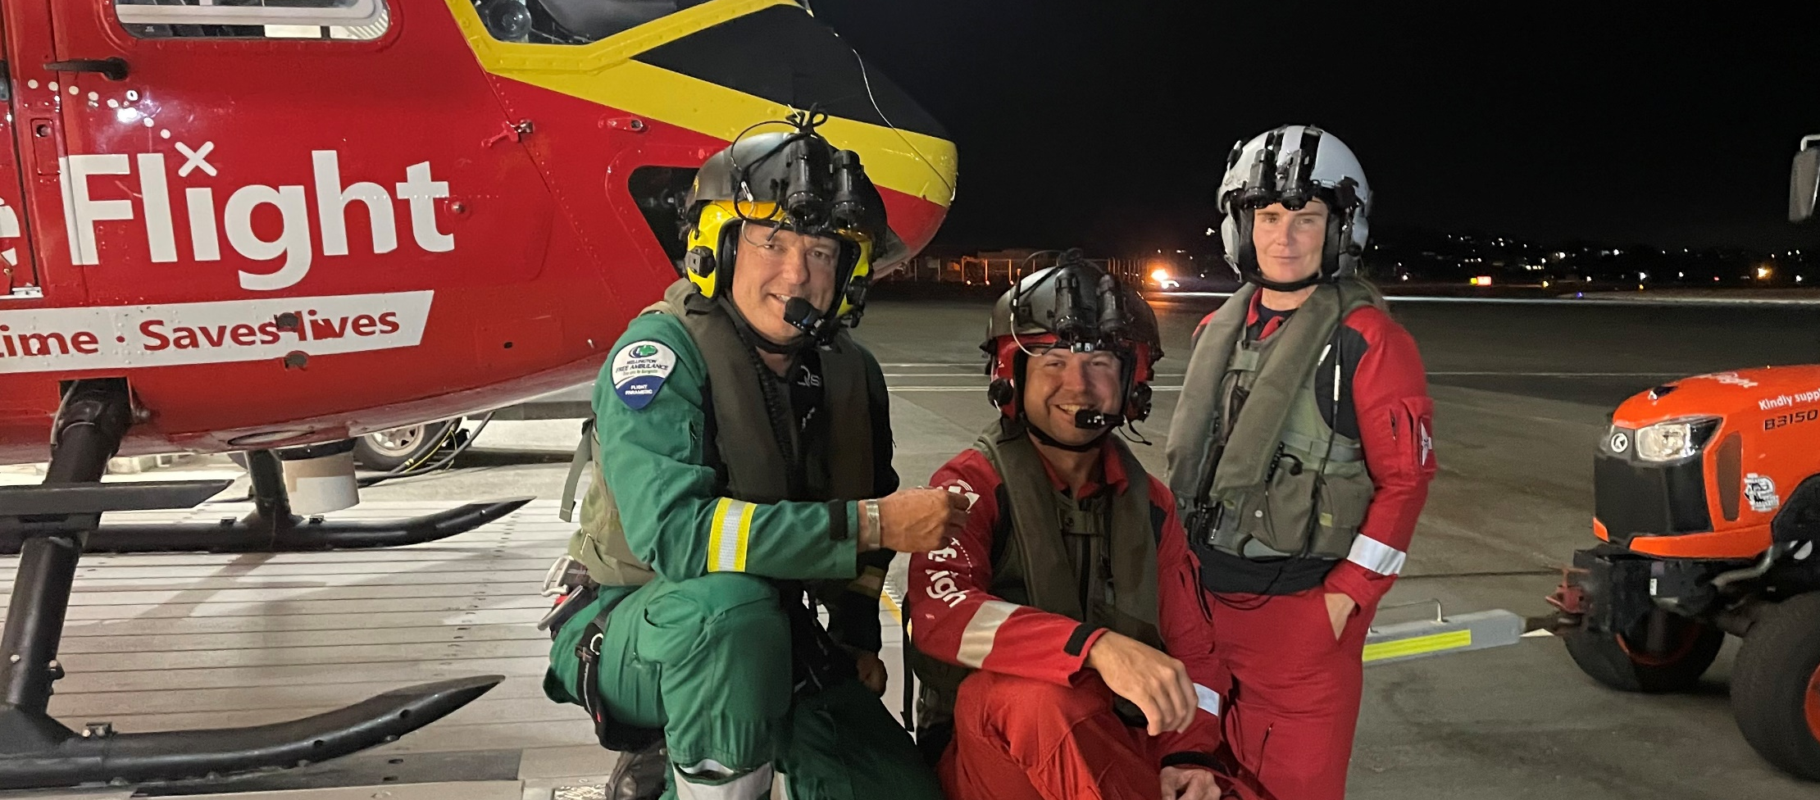
best job
We have the
From heroic rescue missions on remote
bush-clad hills to hospital transfers for a life-saving operation.
Every day, Life Flight makes a difference that will touch many lives. This is made possible by our generous sponsors and donors who fund us to continue our amazing work. Their connection to Life Flight and our brand is essential - and we want our brand out there as much as possible.
Which is where you come in. Thank you for helping us promote Life Flight. Please use our logo and brand elements with love – and follow our guidelines. If you have any questions please give us a call or email us – we are keen to help.

Slide 4
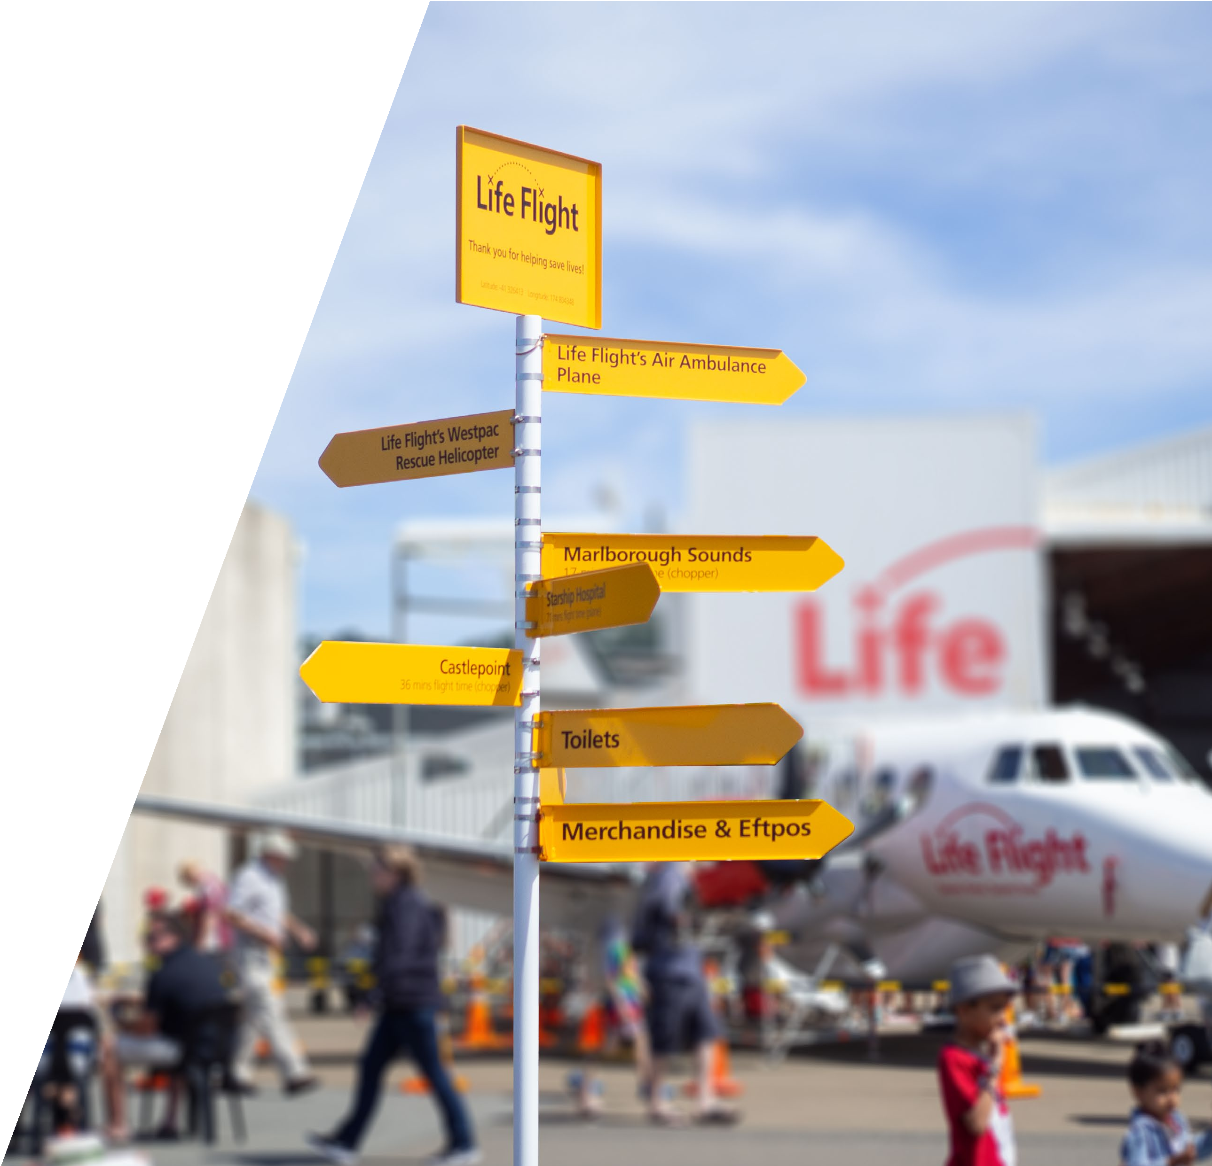
Contents
Kia ora 2 Logo 5
Spacing 7 Background colours 7 Logo guidelines 8 Westpac Logo 9
Typography 10 Primary typeface 10 Alternate Typeface 10 Display typeface 11
Colours 12 Contour device 13 Arc device 14 Photography 15
Templates 16
More information 17

Slide 5
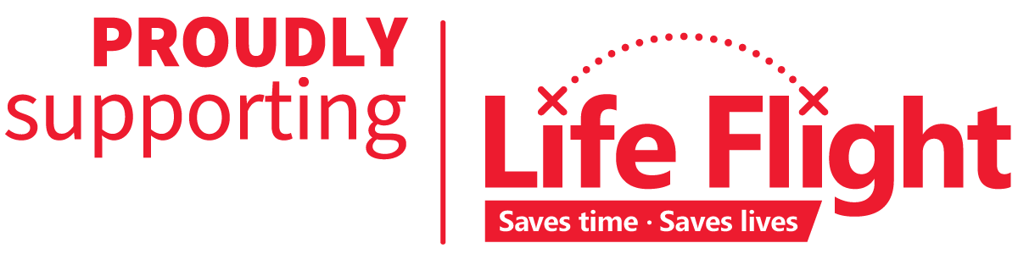


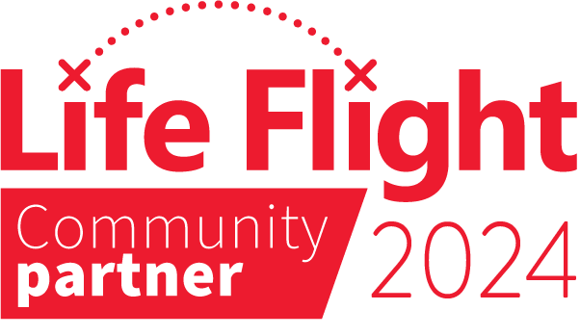

Logo
Proudly Supporting
For our “Community Sponsors” who support between $10,000 - $40,000 annually.
Perfect for use in publications, social media, websites, and more to display your support of Life Flight.
Community Partner
For our “Community Partners” who support between $2,500 - $10,000 annually.
Perfect for use in publications, social media, websites, and more to display your support of Life Flight.
Black and white
Where it is the only option, black and white versions of the Life Flight logos may be used. Do not recolour with other colours from the Life Flight brand.

Slide 6
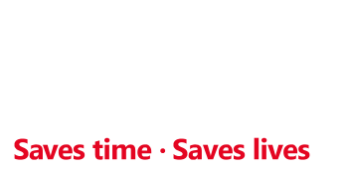
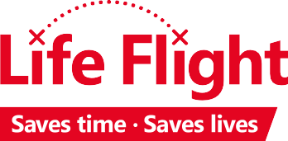
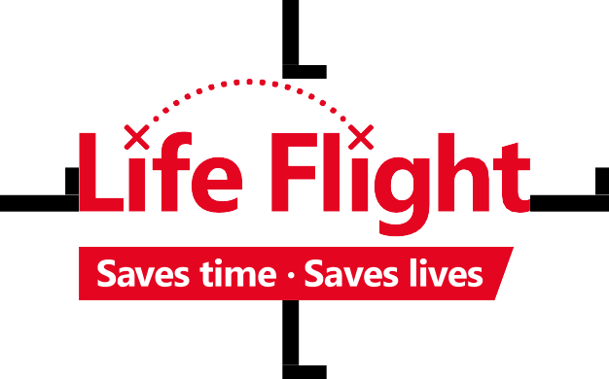
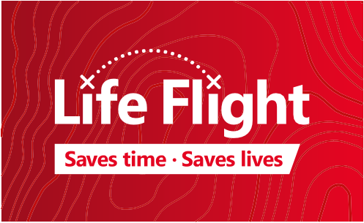

Logo usage
Spacing
The Life Flight logo should have a minimum of one "L-height" of
spacing on all four sides, in both print and digital.
Background
colours
The Life Flight logos may be used on a variety of backgrounds, as specified on this page. Note that the "Saves time • Saves lives" tagline remains a solid colour that contrasts with the primary logo colour.
Note that the logo may be used on simple backgrounds in an appropriate colour, where the background does not detract from the legibility or recognisability of the logo.
Usage on red
Usage on black
Usage on gradient/ subtle background
Usage on off-white

Slide 7
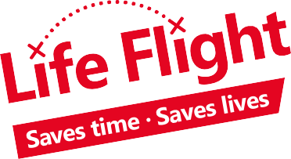
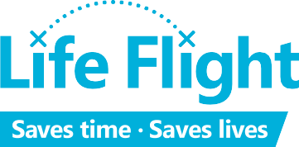


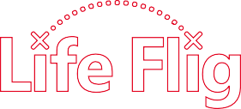
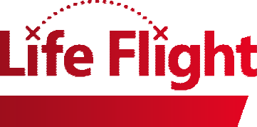












Logo usage
The Life Flight logo and any associated logos should not be:
Logo guidelines
Do not alter, recolor, distort, or misrepresent the Life Flight logo in any way unless laid out in these
guidelines. If in doubt, please contact the Life Flight communications team directly with an example of your intended use.
Rotated
Distorted
Recoloured
Note: the minimum size for all logos is equivalent to the size at which "Saves time • Saves lives" becomes no smaller than 7.5pt.
See pages 5–6 for exact sizes.
Used as an image frame
Outlined
Filled with a gradient
Re-constructed
Low contrast
Embellished
Life Flight
Saves time, saves lives

Slide 8
Typography
Primary Typeface
Primary tyPEfAcE
The primary typeface used by
Life Flight is Source Sans Pro. This is a free, open-source font available at Google Fonts for web and print use.
Source Sans Pro is a clean, modern typeface, built on the legacy of classic sans serifs.
The recommended weights are Light, Regular, and Bold, and their corresponding italics. Light should not be used below 10pt.
If available, OpenType feature “Simple g” should be activated in
programs such as InDesign, Illustrator, and Photoshop.
AltErnAtE tyPEfAcE
When Source Sans Pro is not available, the similar typeface Arial should be used to reinforce the corporate look and feel. Arial can be used for internal communication documents, body copy for donor letters, PowerPoint
and online material.
Source Sans Pro Light
ABCDEFGHIJKLMNOPQRSTUVWXYZ abcdefghijklmnopqrstuvwxyz Life Flight – Saves time • Saves lives
Source Sans Pro Regular
ABCDEFGHIJKLMNOPQRSTUVWXYZ abcdefghijklmnopqrstuvwxyz Life Flight – Saves time • Saves lives
Source Sans Pro Bold
ABCDEFGHIJKLMNOPQRSTUVWXYZ abcdefghijklmnopqrstuvwxyz Life Flight – Saves time • Saves lives
Alternate Typeface
Arial Regular
ABCDEFGHIJKLMNOPQRSTUVWXYZ abcdefghijklmnopqrstuvwxyz Life Flight – Saves time • Saves lives
Arial Bold
ABCDEFGHIJKLMNOPQRSTUVWXYZ abcdefghijklmnopqrstuvwxyz Life Flight – Saves time • Saves lives

Slide 9


Typography
Display Typeface
disPlAy tyPEfAcE
For short words and more decorative elements, 'TheSofy' may be used. Care must be taken to retain legibility, and this typeface shouldn't
be used for more than one or two short words at a time.
This is a paid font, available at Creative Market.
TheSofy
ABC abc • Wellington, Aotearoa –Thanks for your help!
TheSofy should not be used to typeset the words "Life Flight".
Note that this typeface has a variety of versions of each letter, which can be used to minimise repetition, convey and handwritten effect, and retain legibility. For example, the letter 'a' has the
following options:
a a a a a a
Kalam
ABC abc • ellington, Aotearoa – than s for your help!
Alternative display face
To evoke a handwritten feel in longer blocks of text and letters to donors, or for when a paid font isn't available or appropriate, Life Flight uses Kalam from Google Fonts.

Slide 10
Colours
Life Flight's primary colour is
Life Flight Red. Two other darker reds are available for background elements when creating subtle contrast with Life Flight Red, or for background gradient elements. The darker reds should not be used unless used in contrast to Life Flight Red.
Night Grey is available as an accent colour for print and web use to differentiate elements, and for elements for which a bright red is not appropriate.
Life Flight Red
CMYK: C=0 M=100 Y=90 K=0
heX: #e30421
rGB: 228, 5, 33
Dark Red
CMYK: C=0 M=100 Y=100 K=20
heX: #c00d0d
rGB: 192, 13, 13
Darker Red
CMYK: C=0 M=100 Y=80 K=40
heX: #9d0e1c
rGB: 157, 14, 28
Night Grey
CMYK: C=85 M=60 Y=45 K=40
heX: #2b4757
rGB: 43, 71, 87
Black
CMYK: C=0 M=0 Y=0 K=100
heX: #111212
rGB: 17, 18, 18
White
CMYK: C=0 M=0 Y=0 K=0
heX: #ffffff
rGB: 0, 0, 0

Slide 11
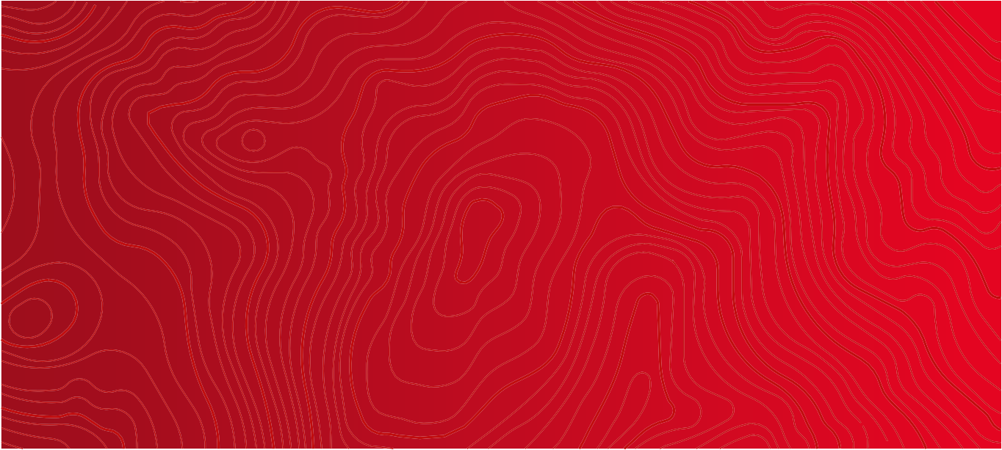
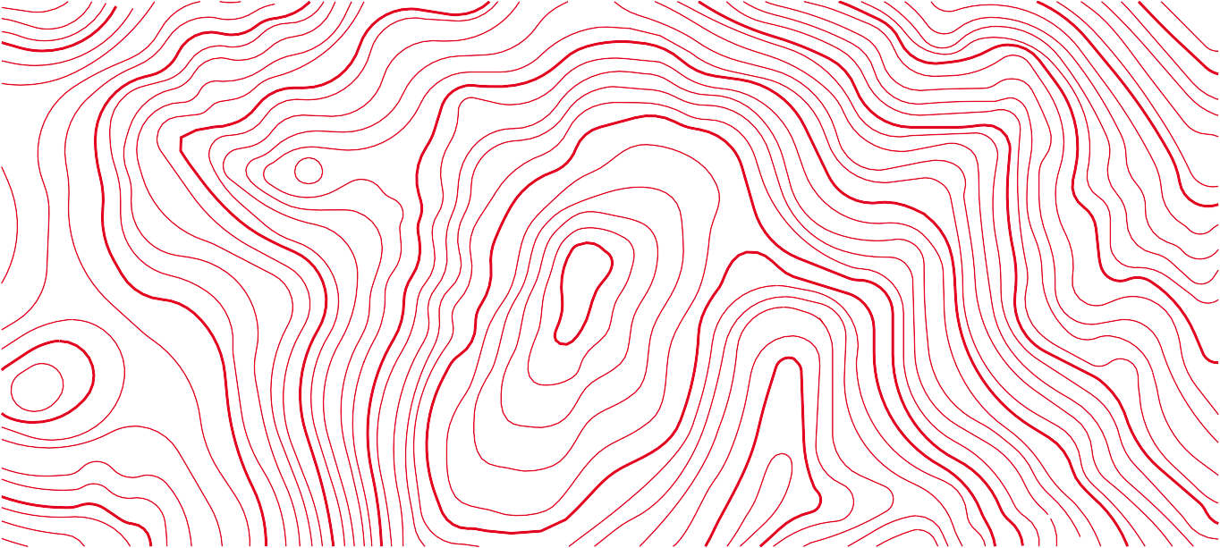
Contour device
Life Flight has a set of topographical contours that may be used as background elements, particularly to emphasise the movement of Life Flight's aircraft across Aotearoa New Zealand.
When used in this way, the colour of the contours should be dark red, and the background colour behind the contours should be a gradient that runs from
Life Flight Red to darker red.
Life Flight Red contours may also be used on a white background, though care must be taken that any foreground elements are still legible.
JPGs of these assets are available from Life Flight. For signwriters etc. that require vector artwork, please get in touch with Life Flight.

Slide 12
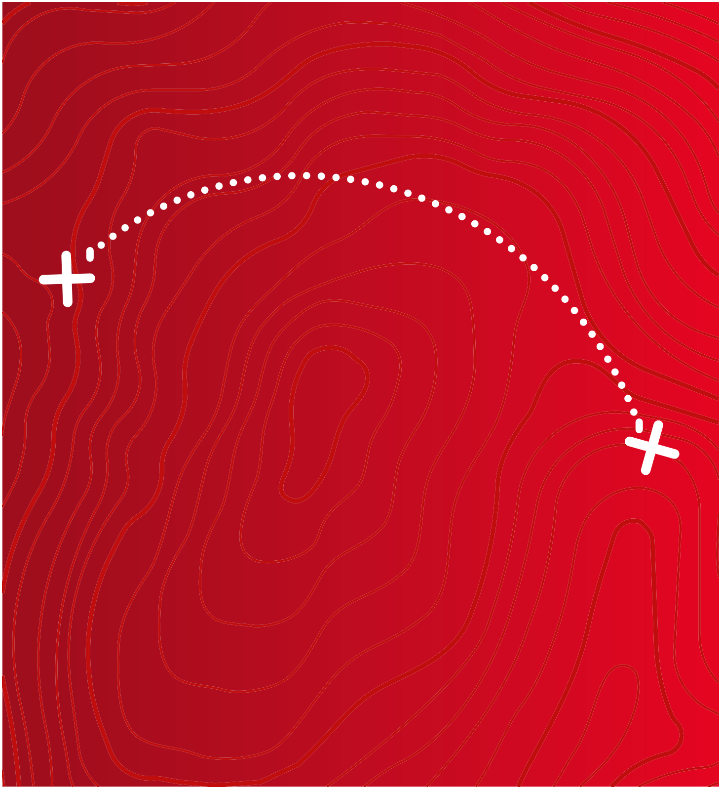
Arc device
The arc device from the Life Flight logo may be used to tell short stories about the work Life Flight does in our community.
The arc above the word mark linking the two crosses represents the direct aerial route we take to ensure we provide the fastest medical care possible.
The two words to be joined by the dotted line should consist of a “challenging” word at the beginning of the journey (left), and a “successful” word at the end (right).
Examples might be:
Mission arrow-right Accomplished Safely arrow-right Delivered Rescue arrow-right Complete
Where appropriate, the arc device should feature over a contoured background to imply movement over the New Zealand landscape.
Mission
Accomplished

Slide 13
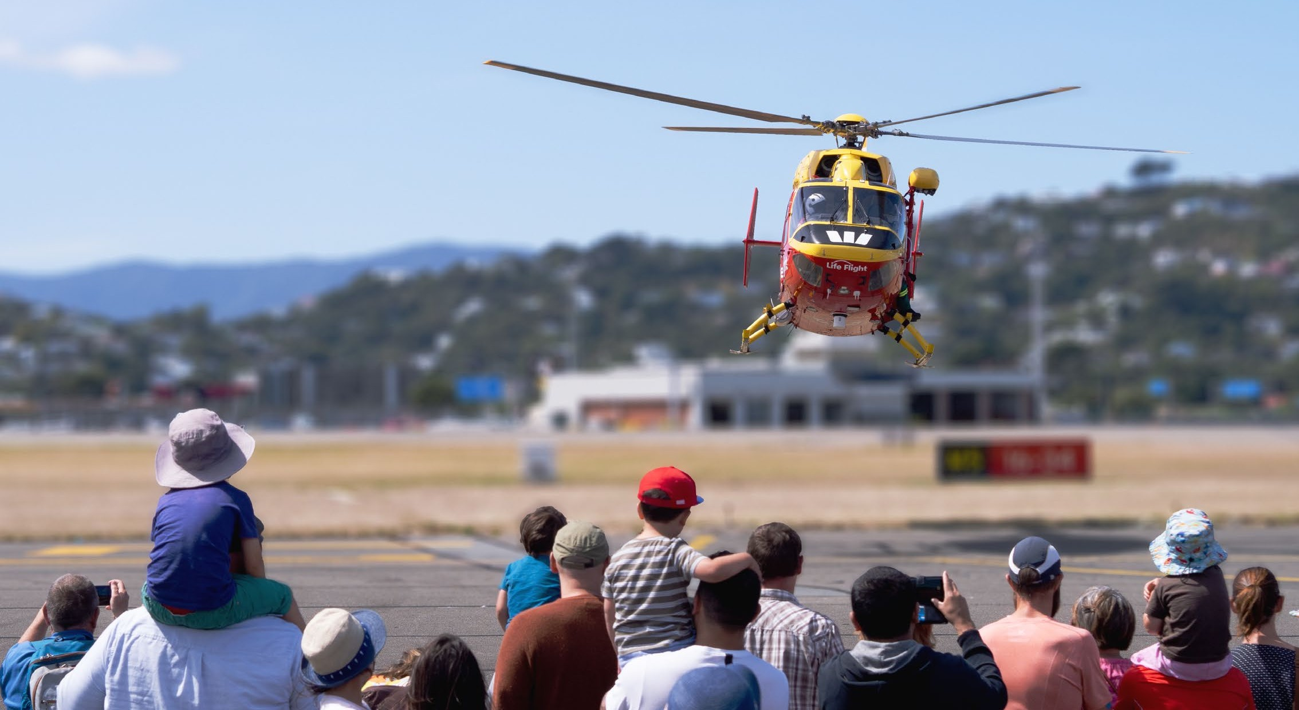
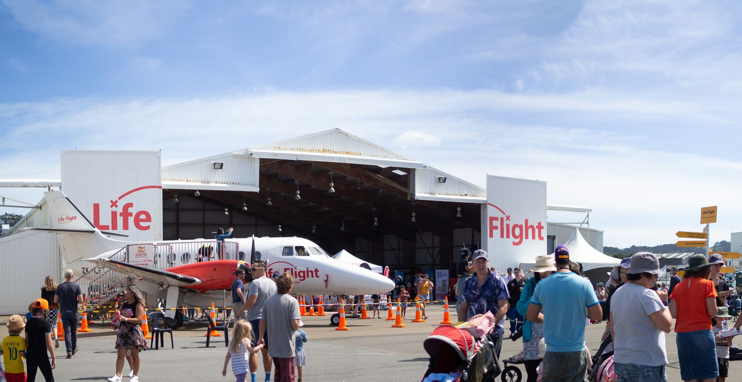
Photography
Wherever possible, photography used alongside the Life Flight brand should be bright, lively and dynamic, and focus on the people and aircraft involved.
Logos
Where logos are visible, the entire logo should be in the shot and not cropped.
People
People's heads should not be cropped and permission to use likenesses should be approved by Life Flight and the people
involved where faces are easily identifiable.
Brand Guidelines • August 2020 • paGe 13

Slide 14
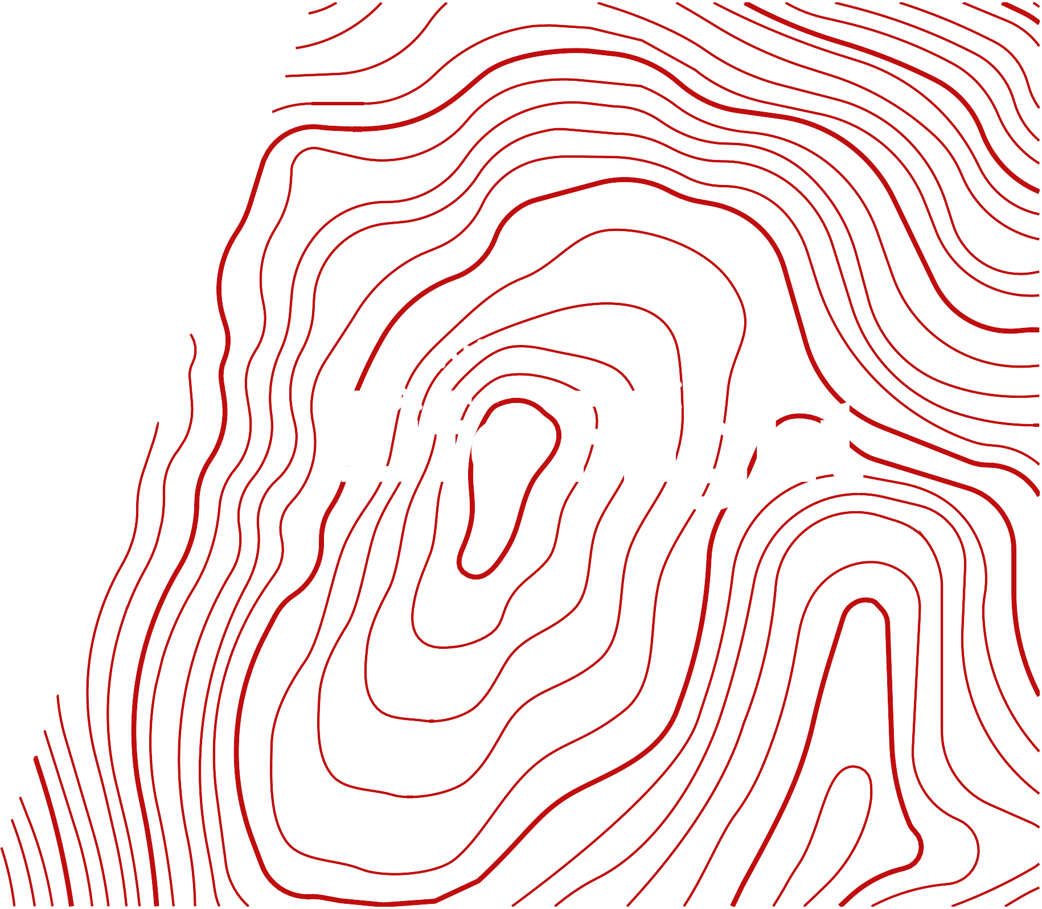


More
information
For more information, or any questions, please contact the Life Flight communications team at:
phone-alt (04) 920 2242
at info@lifeflight.org.nz

